Slide 1
Classification: Basic Concepts
Instructor: Wei Ding
Notes:
Dec 1, finish 24

Slide 2
Classification: Definition
Given a collection of records (training set )
Each record contains a set of attributes, one of the attributes is the class.
Find a model for class attribute as a function of the values of other attributes.
Goal: previously unseen records should be assigned a class as accurately as possible.
A test set is used to determine the accuracy of the model. Usually, the given data set is divided into training and test sets, with training set used to build the model and test set used to validate it.

Slide 3
Classification
Input
Output
Classification
Model
Attribute Set
(x₁, x₂, …,x_{n})
Class label
(y)

Slide 4
Illustrating Classification Task

Slide 5

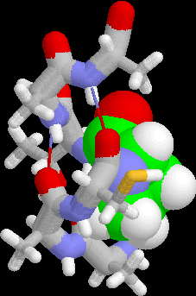
Examples of Classification Task
Predicting tumor cells as benign or malignant
Classifying credit card transactions as legitimate or fraudulent
Classifying secondary structures of protein as alpha-helix, beta-sheet, or random coil
Categorizing news stories as finance, weather, entertainment, sports, etc

Slide 6
Classification Techniques
Decision Tree based Methods
Neural Networks
Naïve Bayes and Bayesian Belief Networks
Support Vector Machines
Logistic Regression

Slide 7
Example of a Decision Tree
categorical
categorical
continuous
class
Splitting Attributes
Refund
Yes
No
NO
MarSt
Single, Divorced
Married
TaxInc
NO
< 80K
> 80K
NO
YES
Training Data
Model: Decision Tree

Slide 8
Another Example of Decision Tree
categorical
categorical
continuous
class
MarSt
Single, Divorced
Married
NO
Refund
Yes
No
NO
TaxInc
< 80K
> 80K
NO
YES
There could be more than one tree that fits the same data!

Slide 9
Model Evaluation
Metrics for Performance Evaluation
How to evaluate the performance of a model?
Methods for Performance Evaluation
How to obtain reliable estimates?
Methods for Model Comparison
How to compare the relative performance among competing models?

Slide 10
Model Evaluation
Metrics for Performance Evaluation
How to evaluate the performance of a model?
Methods for Performance Evaluation
How to obtain reliable estimates?
Methods for Model Comparison
How to compare the relative performance among competing models?

Slide 11
Metrics for Performance Evaluation
Focus on the predictive capability of a model
Rather than how fast it takes to classify or build models, scalability, etc.
Confusion Matrix:
 | PREDICTED CLASS
ACTUAL CLASS |  | Class=Yes | Class=No
 | Class=Yes | a | b
 | Class=No | c | d
a: TP (true positive)
b: FN (false negative)
c: FP (false positive)
d: TN (true negative)

Slide 12
Metrics for Performance Evaluation…
Most widely-used metric:
 | PREDICTED CLASS
ACTUAL CLASS |  | Class=Yes | Class=No
 | Class=Yes | a (TP) | b (FN)
 | Class=No | c (FP) | d (TN)

Slide 13
Limitation of Accuracy
Consider a 2-class problem
Number of Class 0 examples = 9990
Number of Class 1 examples = 10
If model predicts everything to be class 0, accuracy is 9990/10000 = 99.9 %
Accuracy is misleading because model does not detect any class 1 example

Slide 14
Cost Matrix
 | PREDICTED CLASS
ACTUAL CLASS | C(i|j) | Class=Yes | Class=No
 | Class=Yes | C(Yes|Yes) | C(No|Yes)
 | Class=No | C(Yes|No) | C(No|No)
C(i|j): Cost of misclassifying class j example as class i

Slide 15
Computing Cost of Classification
Cost Matrix | PREDICTED CLASS
ACTUAL CLASS | C(i|j) | + | -
 | + | -1 | 100
 | - | 1 | 0
Model M₁ | PREDICTED CLASS
ACTUAL CLASS |  | + | -
 | + | 150 | 40
 | - | 60 | 250
Model M₂ | PREDICTED CLASS
ACTUAL CLASS |  | + | -
 | + | 250 | 45
 | - | 5 | 200
Accuracy = 80%
Cost = 3910 = -150 +4000 + 60
Accuracy = 90%
Cost = 4255 = -250 + 4500+5

Slide 16
Cost vs Accuracy
Count | PREDICTED CLASS
ACTUAL CLASS |  | Class=Yes | Class=No
 | Class=Yes | a | b
 | Class=No | c | d
Accuracy is proportional to cost if 1. C(Yes|No)=C(No|Yes) = q 2. C(Yes|Yes)=C(No|No) = p
N = a + b + c + d
Accuracy = (a + d)/N
Cost = p (a + d) + q (b + c)
= p (a + d) + q (N – a – d)
= q N – (q – p)(a + d)
= N [q – (q-p) × Accuracy]
Cost | PREDICTED CLASS
ACTUAL CLASS |  | Class=Yes | Class=No
 | Class=Yes | p | q
 | Class=No | q | p

Slide 17


Cost-Sensitive Measures
Precision is biased towards C(Yes|Yes) & C(Yes|No)
Recall is biased towards C(Yes|Yes) & C(No|Yes)
F-measure is biased towards all except C(No|No)

Slide 18
Interpretation of Precision and Recall
 | PREDICTED CLASS
ACTUAL CLASS |  | Class=Yes | Class=No
 | Class=Yes | a (TP) | b (FN)
 | Class=No | c (FP) | d (TN)
Precision determines the fraction of records that actually turns out to be positive in the group the classifier has declared as a positive class.
The higher the precision is, the lower the number of false positive errors committed by the classifier.
Recall measures the fraction of positive examples correctly predicted by the classifier.
Classifiers with large recall have very few positive examples misclassified as the negative class.

Slide 19
Model Evaluation
Metrics for Performance Evaluation
How to evaluate the performance of a model?
Methods for Performance Evaluation
How to obtain reliable estimates?
Methods for Model Comparison
How to compare the relative performance among competing models?

Slide 20
Methods for Performance Evaluation
How to obtain a reliable estimate of performance?
Performance of a model may depend on other factors besides the learning algorithm:
Class distribution
Cost of misclassification
Size of training and test sets

Slide 21
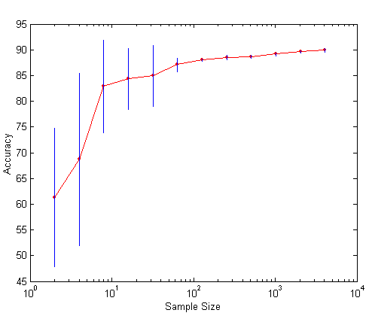
Learning Curve
Learning curve shows how accuracy changes with varying sample size
Requires a sampling schedule for creating learning curve:
Arithmetic sampling (Langley, et al)
Geometric sampling (Provost et al)
Effect of small sample size:
Bias in the estimate
Variance of estimate
Notes:
Arithmetic sampling, using the schedule sa=no + (i*n_delta)= {n0, n0+n_delta, n0+2n_delta, …, N}. Fro example, {100, 200, 300, …,N}
Geometric Sampling [Provost, Jenson & Oates KDD 1999] uses a schedule
S_{g}= <n₀, a.n₀,a².n₀, ………,a^{k}.n₀>
An example geometric schedule is: <100,200,400,800, . . .>

Slide 22
Methods of Estimation
Holdout
Reserve 2/3 for training and 1/3 for testing
Random subsampling
Repeated holdout
Cross validation
Partition data into k disjoint subsets
k-fold: train on k-1 partitions, test on the remaining one
Leave-one-out: k=n
Stratified sampling
oversampling vs undersampling
Bootstrap
Sampling with replacement
Notes:
Stratified sampling: when building classification models for rare classes, it is critical that the rare classes be adequately represented in the sample. Hence, a sampling scheme that can accommodate differing frequencies for the items of interest is needed. Stratified sampling, which starts with prespecified groups of objects, is such approach.
Bootstrap method has assumption
Your sample is a valid representative of the population
Bootstrap method will take sampling with replacement from the sample. Each sub sampling is independent and identical distribution (i.i.d.). In other word, it assumes that the sub samples come from the same distribution of the population, but each sample is drawn independently from the other samples.

Slide 23
Model Evaluation
Metrics for Performance Evaluation
How to evaluate the performance of a model?
Methods for Performance Evaluation
How to obtain reliable estimates?
Methods for Model Comparison
How to compare the relative performance among competing models?

Slide 24
ROC (Receiver Operating Characteristic)
Developed in 1950s for signal detection theory to analyze noisy signals
Characterize the trade-off between positive hits and false alarms
ROC curve plots TP rate (on the y-axis) against FP rate (on the x-axis)
Performance of each classifier represented as a point on the ROC curve
changing the threshold of algorithm, sample distribution or cost matrix changes the location of the point

Slide 25
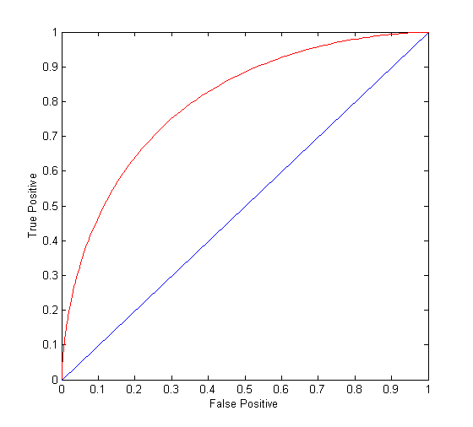
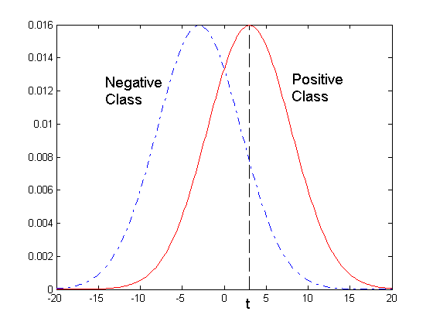
ROC Curve
- 1-dimensional data set containing 2 classes (positive and negative)
- any points located at x > t is classified as positive
At threshold t:
TP=0.5, FN=0.5, FP=0.12, TN=0.88

Slide 26
ROC Curve
(TP-Rate, FP-Rate):
(0,0): declare everything to be negative class
(1,1): declare everything to be positive class
(1,0): ideal
Diagonal line:
Random guessing
Below diagonal line:
prediction is opposite of the true class

Slide 27
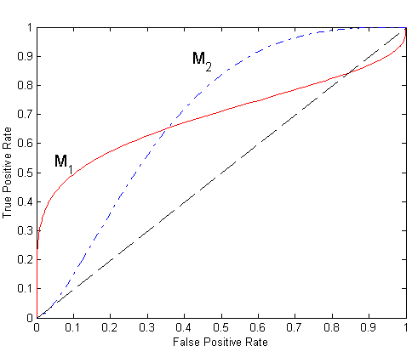
Using ROC for Model Comparison
No model consistently outperform the other
M₁ is better for small FPR
M₂ is better for large FPR
Area Under the ROC curve
Ideal:
Area = 1
Random guess:
Area = 0.5

Slide 28
How to Construct an ROC curve
Use classifier that produces posterior probability for each test instance P(+|A)
Sort the instances according to P(+|A) in decreasing order
Apply threshold at each unique value of P(+|A)
Count the number of TP, FP, TN, FN at each threshold
TP rate, TPR = TP/(TP+FN)
FP rate, FPR = FP/(FP + TN)
Instance | P(+|A) | True Class
1 | 0.95 | +
2 | 0.93 | +
3 | 0.87 | -
4 | 0.85 | -
5 | 0.85 | -
6 | 0.85 | +
7 | 0.76 | -
8 | 0.53 | +
9 | 0.43 | -
10 | 0.25 | +
Notes:
TPR → recall

Slide 29
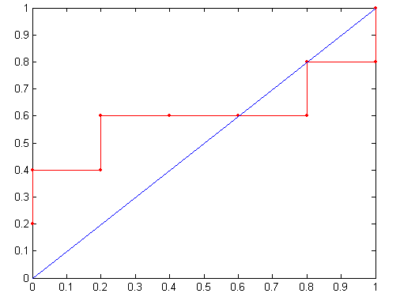
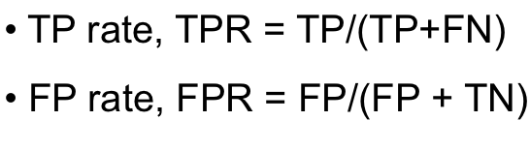
How to construct an ROC curve
Threshold >=
ROC Curve:

Slide 30
In-class-Exercise: How to Construct an ROC curve
Use classifier that produces posterior probability for each test instance P(+|A)
Sort the instances according to P(+|A) in decreasing order
Apply threshold at each unique value of P(+|A)
Count the number of TP, FP, TN, FN at each threshold
TP rate, TPR = TP/(TP+FN)
FP rate, FPR = FP/(FP + TN)
Instance | P(+|A) | True Class
1 | 0.78 | +
2 | 0.64 | +
3 | 0.75 | -
4 | 0.98 | -
5 | 0.42 | -
6 | 0.31 | +
7 | 0.54 | -
8 | 0.77 | +
9 | 0.89 | -
10 | 0.25 | +
Notes:
TPR → recall

Slide 31
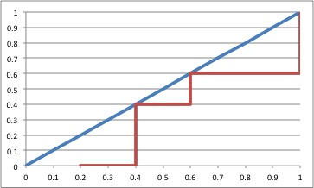
In class Exercise
class | + | + | - | - | + | - | + | + | - | -
threshold | 0.25 | 0.31 | 0.42 | 0.54 | 0.64 | 0.75 | 0.77 | 0.78 | 0.89 | 0.98
TP | 5 | 4 | 3 | 3 | 3 | 2 | 2 | 1 | 0 | 0
FP | 5 | 5 | 5 | 4 | 3 | 3 | 2 | 2 | 2 | 1
TN | 0 | 0 | 0 | 1 | 2 | 2 | 3 | 3 | 3 | 4
FN | 0 | 1 | 2 | 2 | 2 | 2 | 3 | 4 | 5 | 5
TPR | 1 | 0.8 | 0.6 | 0.6 | 0.6 | 0.4 | 0.4 | 0.2 | 0 | 0
FPR | 1 | 1 | 1 | 0.8 | 0.6 | 0.6 | 0.4 | 0.4 | 0.4 | 0.2

